Slide 1

Week 0: LINUX Lab
Human Population and Computational Genetics
(Adapted from Dr. Brenna Henn’s UCDavis Course)
Oshiomah Oyageshio
PhD Candidate

Slide 2

Genetic Ancestry
L0
V
D

Slide 3
Pedigrees and Disease
Notes:
KE family pedigree

Slide 4
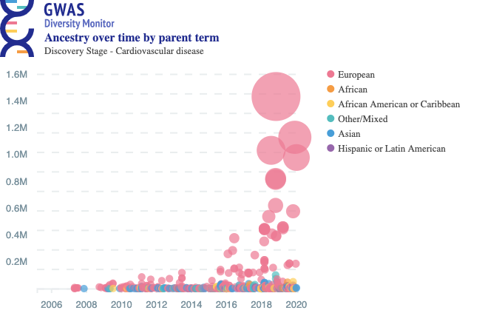
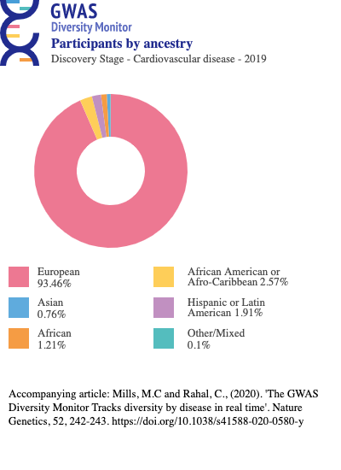
Complex Trait Discovery: GWAS

Slide 5
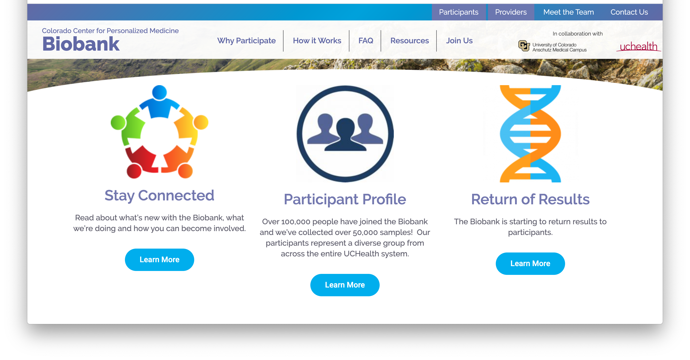
Biobanks

Slide 6

Using the Genome Center High Performance Computing Cluster

Slide 7
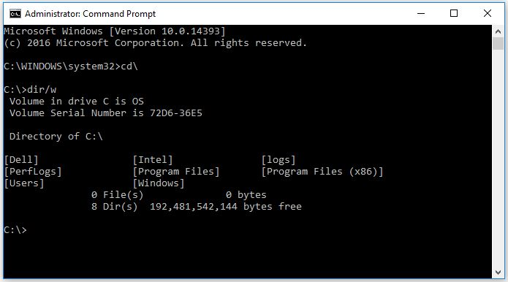
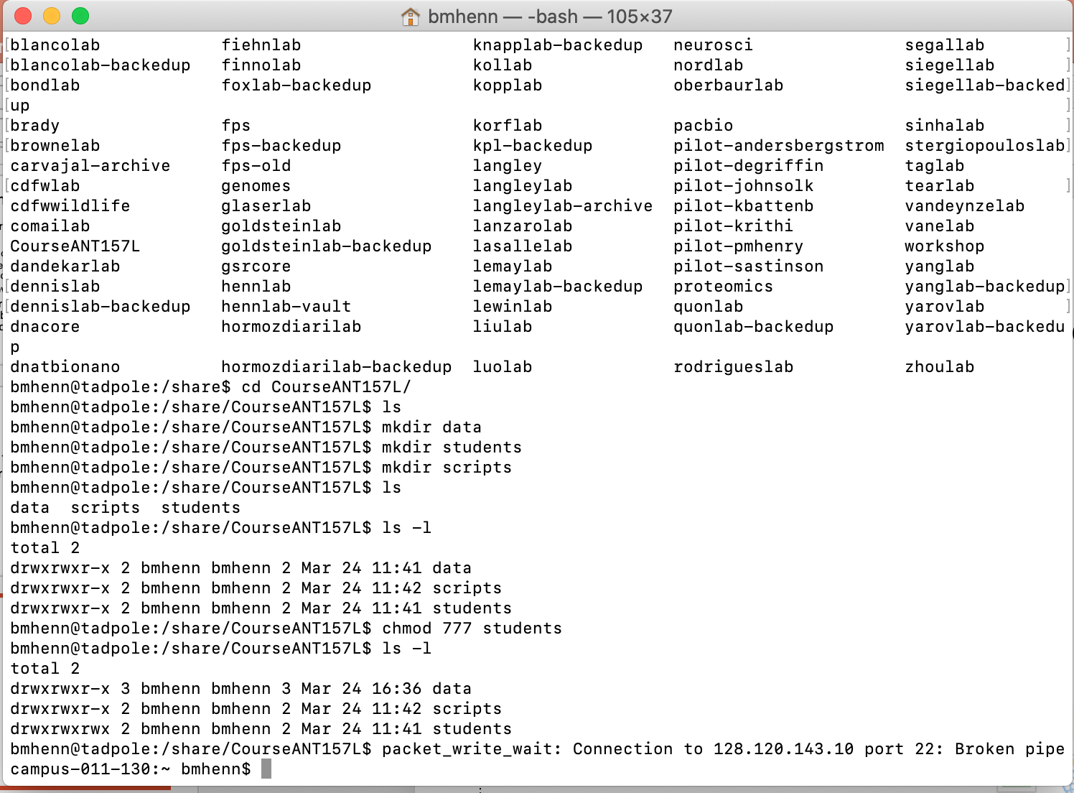
For windows: Open Command Prompt
Search for application to open →

Slide 8
On a Mac: Open your Terminal
Click on the application to open →

Slide 9
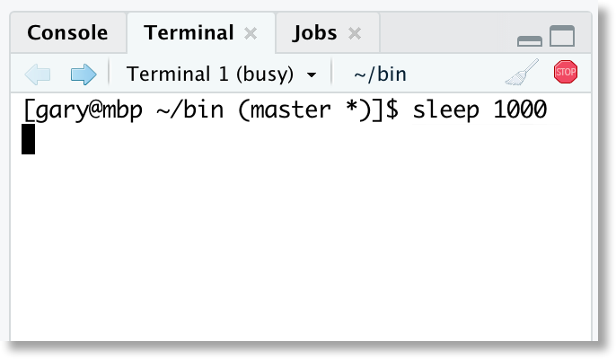
Backup Option: Rstudio

Slide 10
SSH
Secure Shell Login
$ ssh username@server
$ ssh oshiomah@tadpole.genomecenter.ucdavis.edu
Then type your password
You wrote it down, right? ;-)
Password will not show up as you type
When you log in, you are taken to your home directory
Need to move to the class directory
$ cd /share/ant157

Slide 11
SSH
Terminal or Command Line window
“$” represents a place for you to type a command
If you see this on a slide, don’t actually type “$” but rather type a command in the window
“Directory” is a fancy word for a folder

Slide 12
Let’s try that…

Slide 13
print working directory
When you are not sure what directory you are in you can use the command pwd
$ pwd
prints working directory

Slide 14
make a directory
$ mkdir foldername
$ cd students/
$ mkdir brenna

Slide 15
list directory contents
$ ls
lists files & directories
Switches
$ command [options]
$ ls –l #long form
$ ls –lt #long form sorted by time
$ ls –ltr #long form, sorted by time, reverse order
$ ls –lh #long form, human readable
Notes:
options are always in [ … ]

Slide 16
change directories
$ cd /path/to/directory
$ cd data #cd to ‘data’ directory
$ cd ~ #home directory
$ cd .. #up one level
$ cd ../.. #up two levels
$ cd - #previous directory
. ← current directory
.. ← directory one level up

Slide 17
filename conventions
no spaces
as description and brief as possible
lower case is better
camelCase or no_camel_case
sometimes you cannot name files with a complete description of the file, so create a README.txt file

Slide 18
creating & deleting files
$ touch file.txt #creates blank file (file.txt)
$ rm file.txt #removes file.txt (cannot undo)
$ rm * #removes all files in directory
$ rm output.*
#removes anything starting with output, followed by any file extension

Slide 19
copy a file
$ cp path/to/file/I/Want local/folder
$ mkdir week0
$ cd week0
$ cp -r /share/ant157/data/week1_unix/data-shell/ .
What does “.” mean?
How do I check if this has worked?

Slide 20
file organization
should be able to find files without knowing much about dataset
$ tree
$ tree -d -L 2
#only directories & two levels deep

Slide 21
displaying files
$ cat file.txt #prints file to terminal
$ less file.txt #shows preview of file.txt
$ head file.txt #prints first 10 lines to terminal
$ head –n 100 file.txt #prints first 100 lines to terminal
$ tail file.txt #prints last 10 lines to terminal

Slide 22
command redirection
$ ls | less #output of ls piped over to less
Tap Q on your keyboard to escape
$ ls | grep .txt | less
# output of ls piped to grep (which searches for searches for .txt)
the matches from grep are piped to less

Slide 23
command redirection
$ ls –l > DirectoryList.txt
# output from ls is redirected to a file called DirectoryList.txt
$ ls –l | grep creatures > creatures.txt
# output from ls is piped to grep, results are sent to file called matches.txt
> #creates new file (removes existing file)
>> #appends to existing file

Slide 24
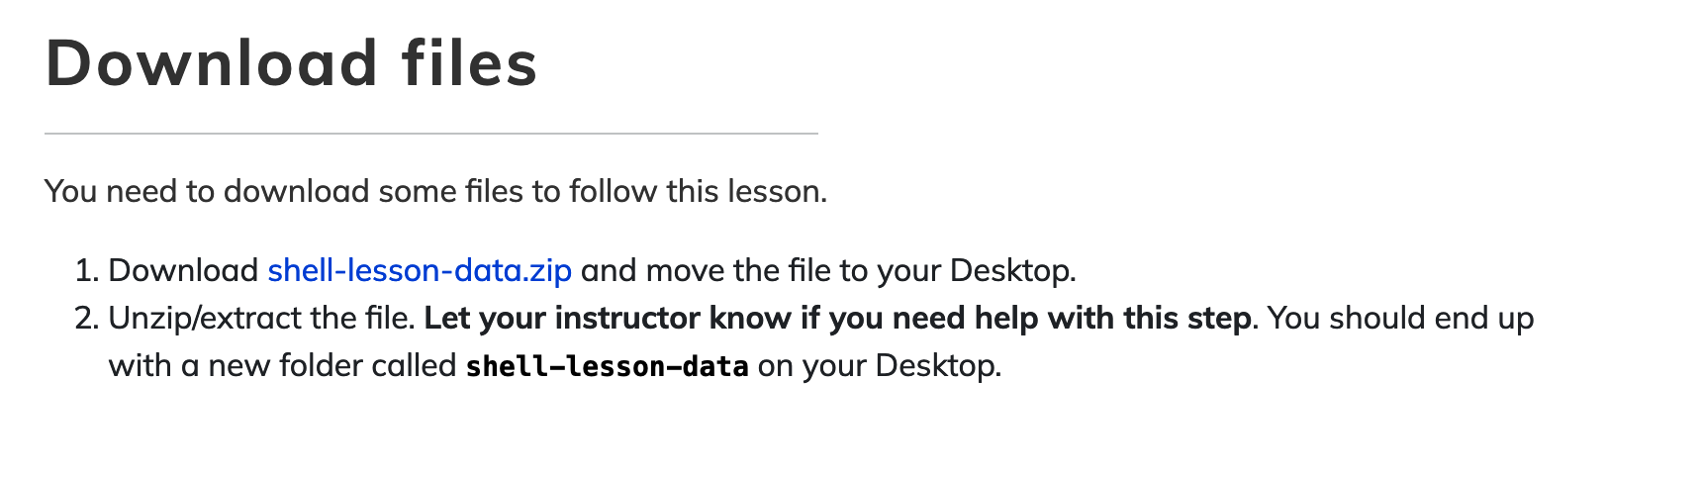
Assignment 0: UNIX / BASH
http://swcarpentry.github.io/shell-novice/
We will now leave the HPCC and work on our desktop
Open a new terminal tab/window

Slide 25
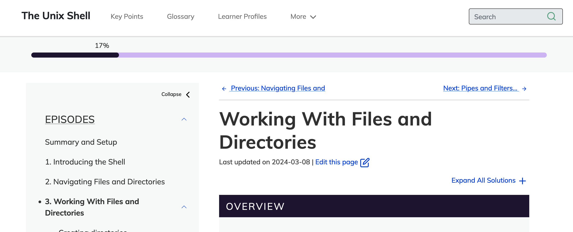
Assignment 0: UNIX / BASH
http://swcarpentry.github.io/shell-novice/
Not graded
Working with Files and Directories
Skip the exercises with using the GUI file explorer

Slide 26
Next Week!
Optional Homework: omplete all exercises in swcarpentry github
Lecture: Intro to Human Genetics
Lab: Allelic and genotypic frequencies with application to SNP array data

